Slide 1


Capstone Project: InPower Social Media Platform Project
Team Members:
Rohan Sharma
Pradumn Kumar .
Irene Chan
Ka Hing Ma
Sai Hoi Yeung

Slide 2

Objectives
Deliver a vibrant online platform featuring e-magazines and engaging blogs, delivering the freshest insights and trends.

Slide 3




Tools
React
Node.js
Microsoft Azure
SQL Database

Slide 4
Challenges
Lack of a backend server to manage data processing and interactions between users and the platform.
No database in place to store and organize the information required for seamless functionality.
APIs are yet to be developed to facilitate communication between the frontend interfaces and the backend systems.

Slide 5
Solutions
Drawing inspiration from the frontend interface, we've leveraged node.js to craft a robust backend server.
Harnessing insights gleaned from the front end, we've established an SQL database hosted on the Microsoft Azure Cloud, ensuring scalability and reliability.
Building upon the front-end insights, we've meticulously developed corresponding APIs to seamlessly retrieve and manage the data, enhancing user experience and efficiency.

Slide 6
Demonstration

Slide 7
Thank You! Q&A

Slide 8
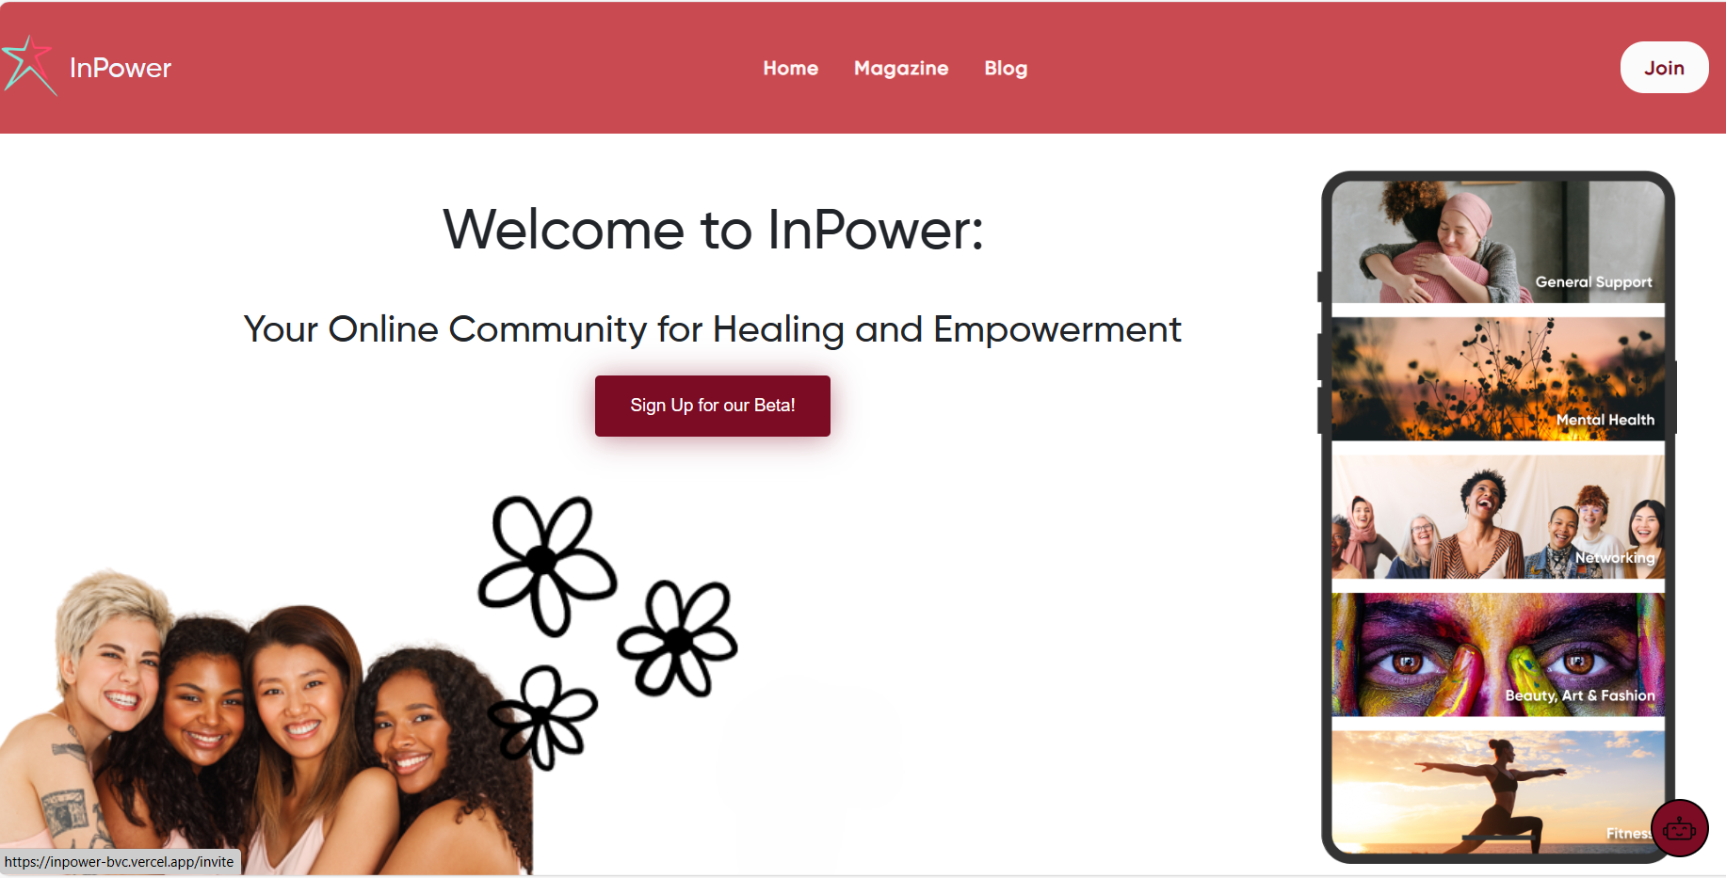
Layout

Slide 9
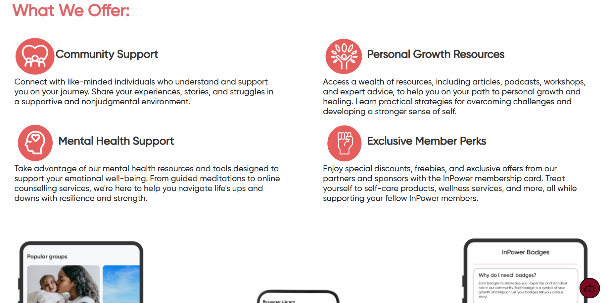
Layout

Slide 10
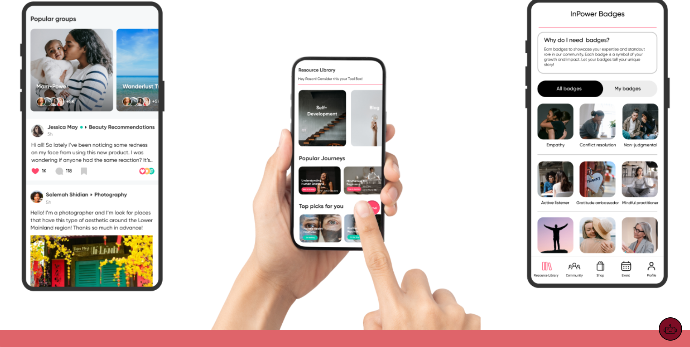
Layout

Slide 11
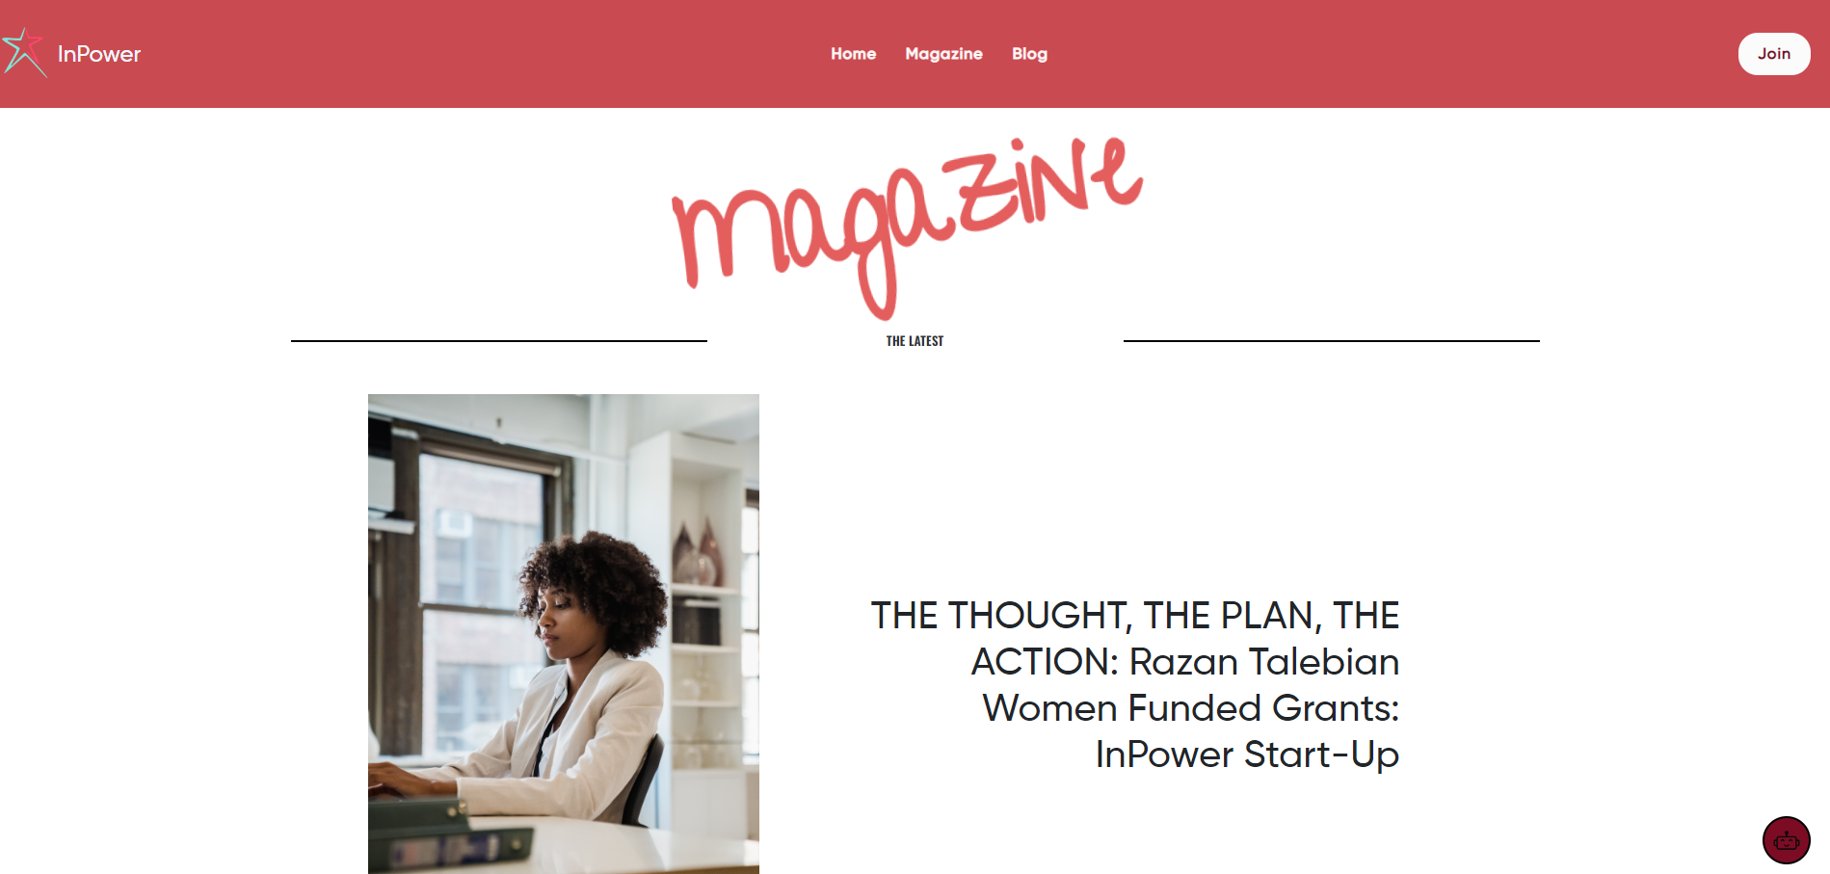
Layout

Slide 12
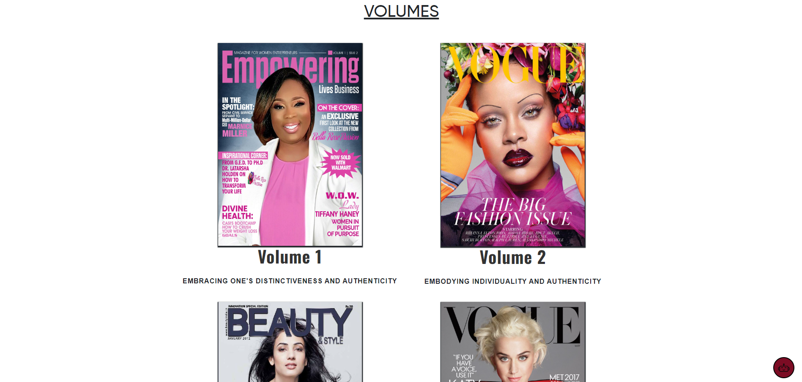
Layout

Slide 13

Layout

Slide 14
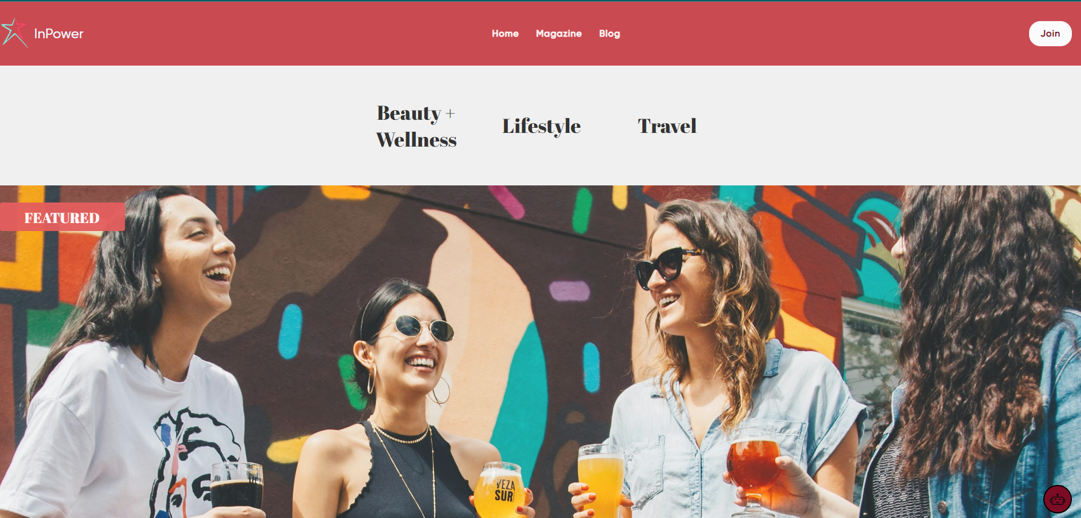
Layout

Slide 15
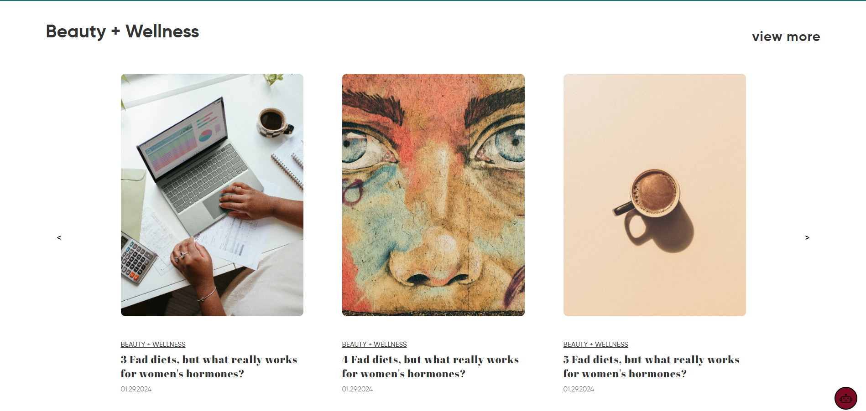
Layout

Slide 16
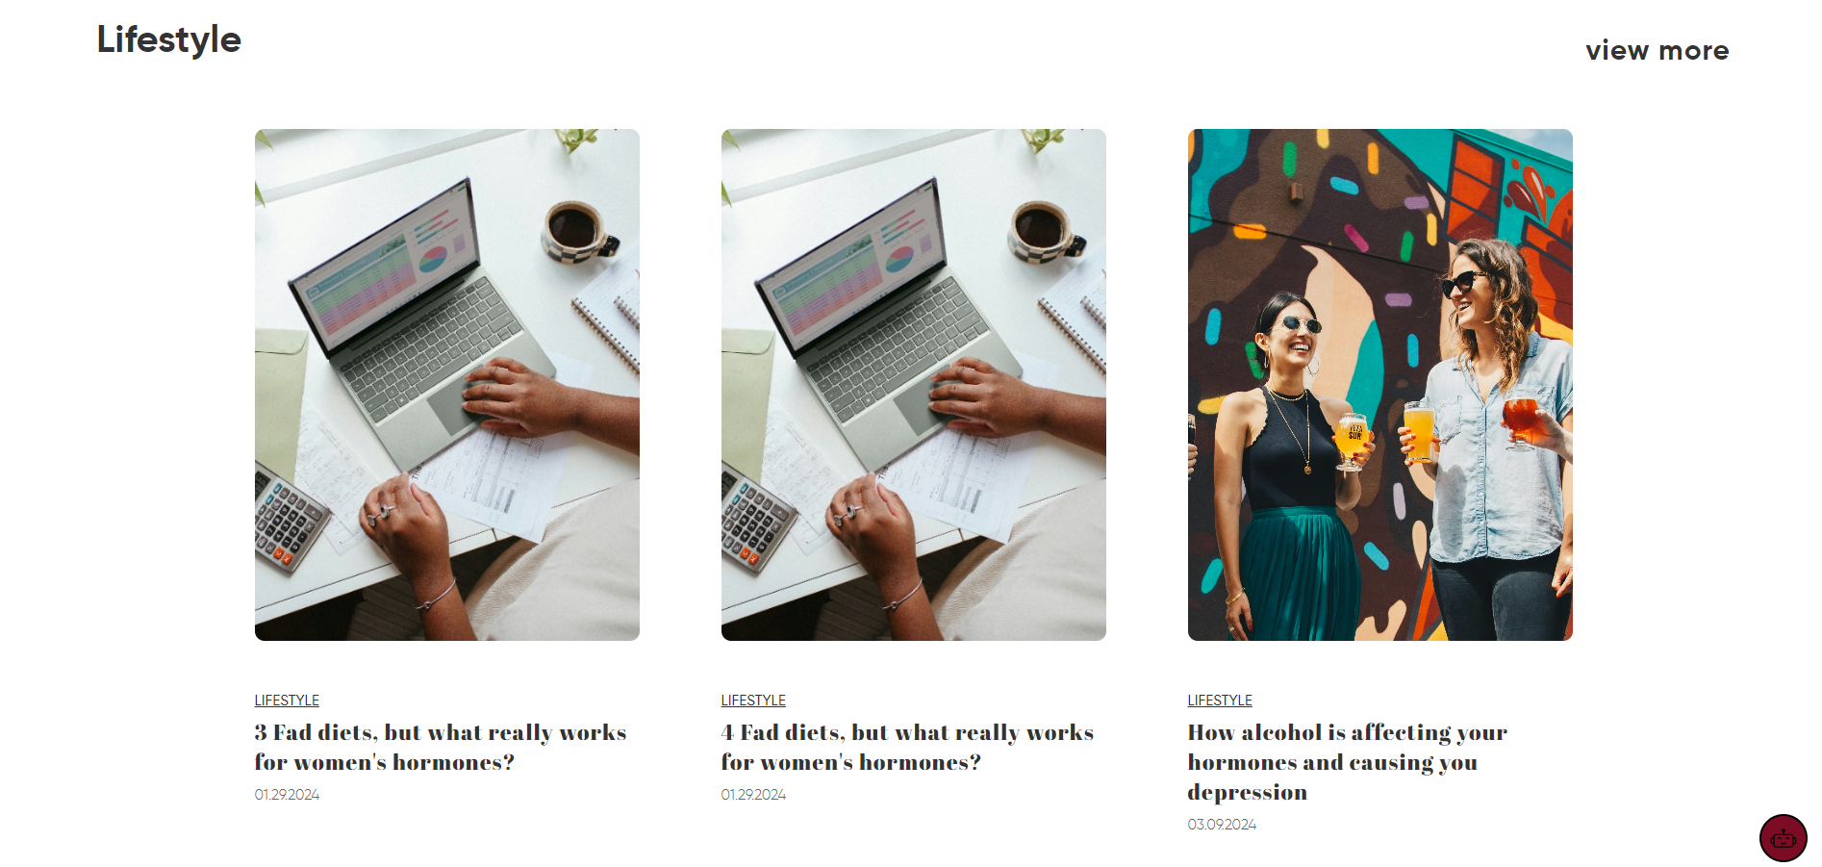
Layout

Slide 17
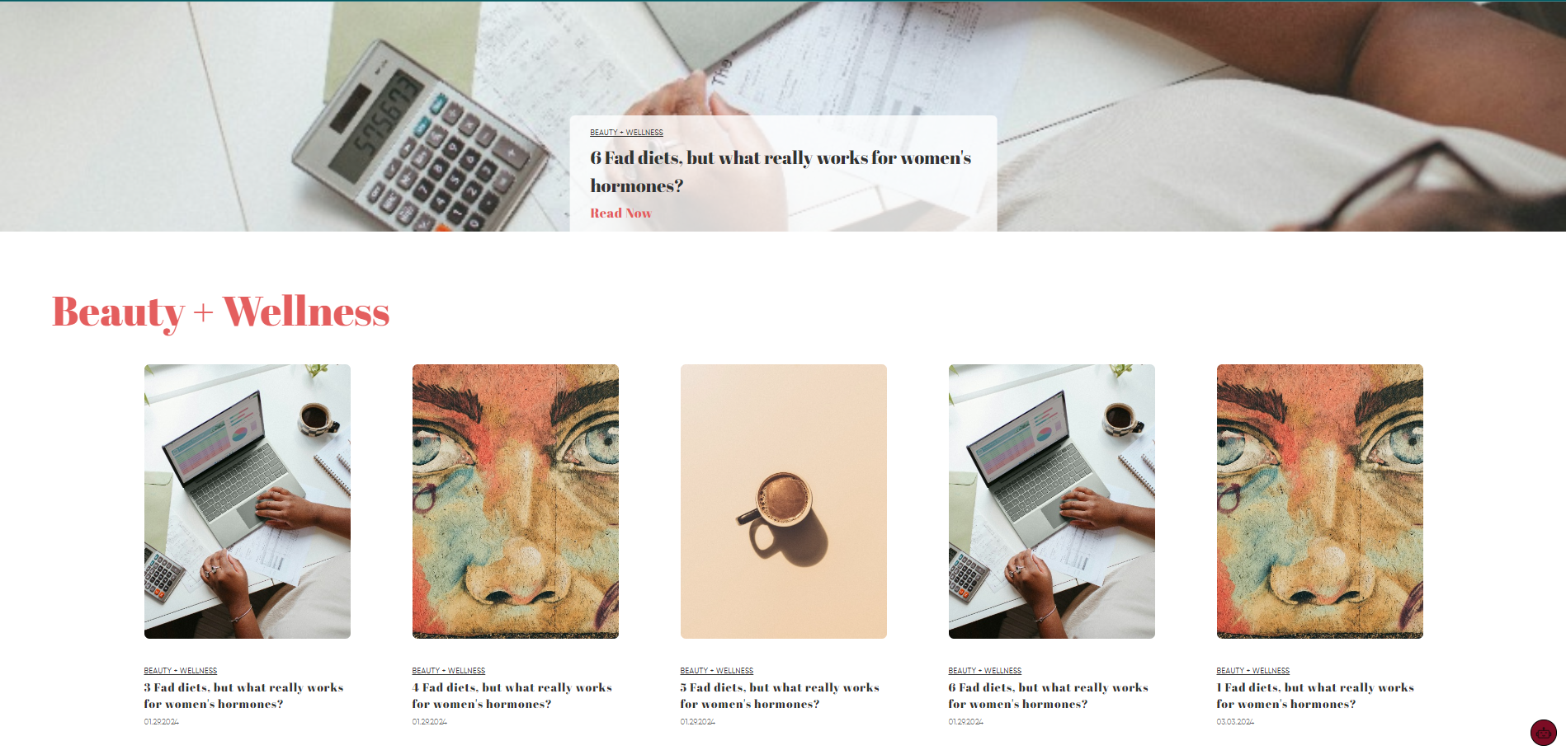
Layout

Slide 18
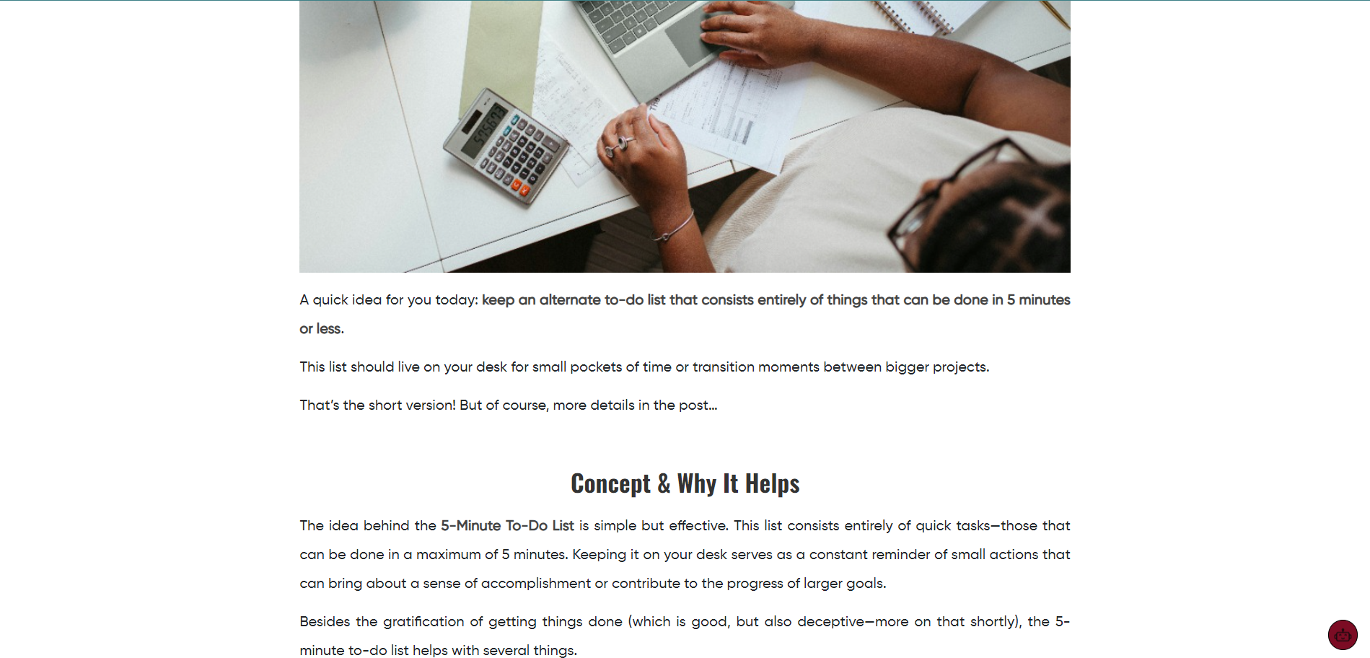
Layout

Slide 19
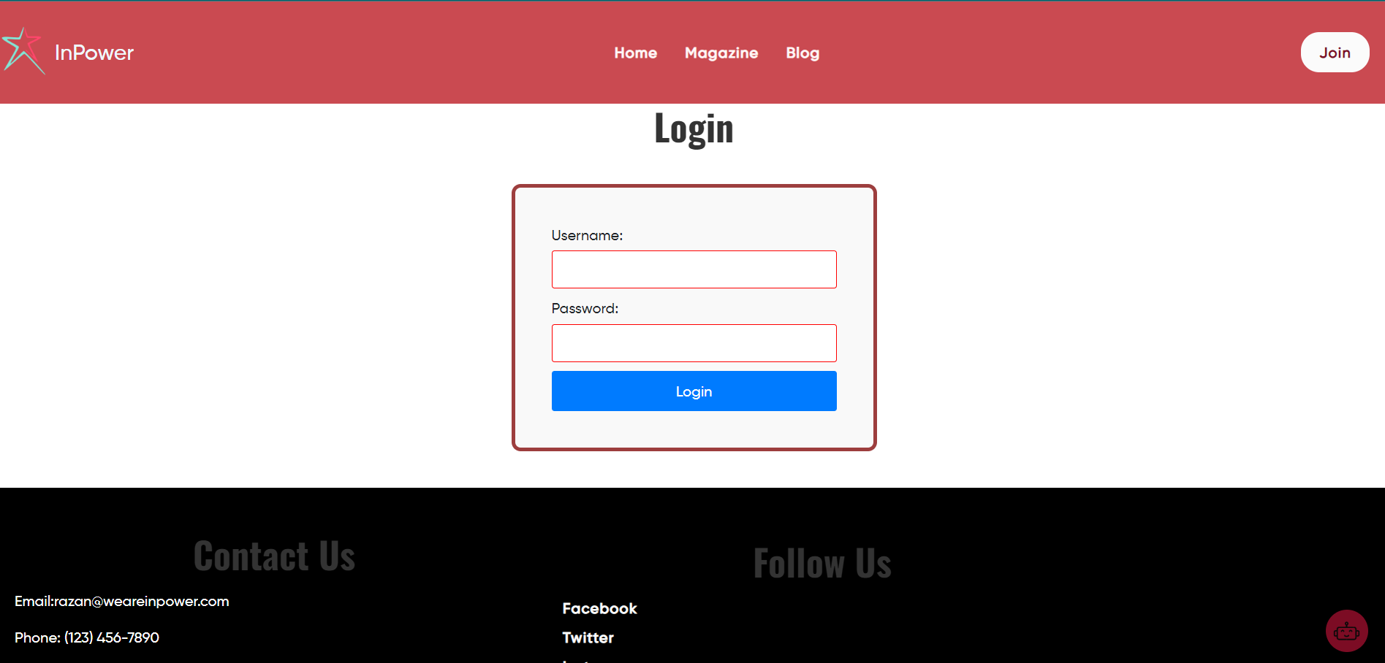
Layout

Slide 20
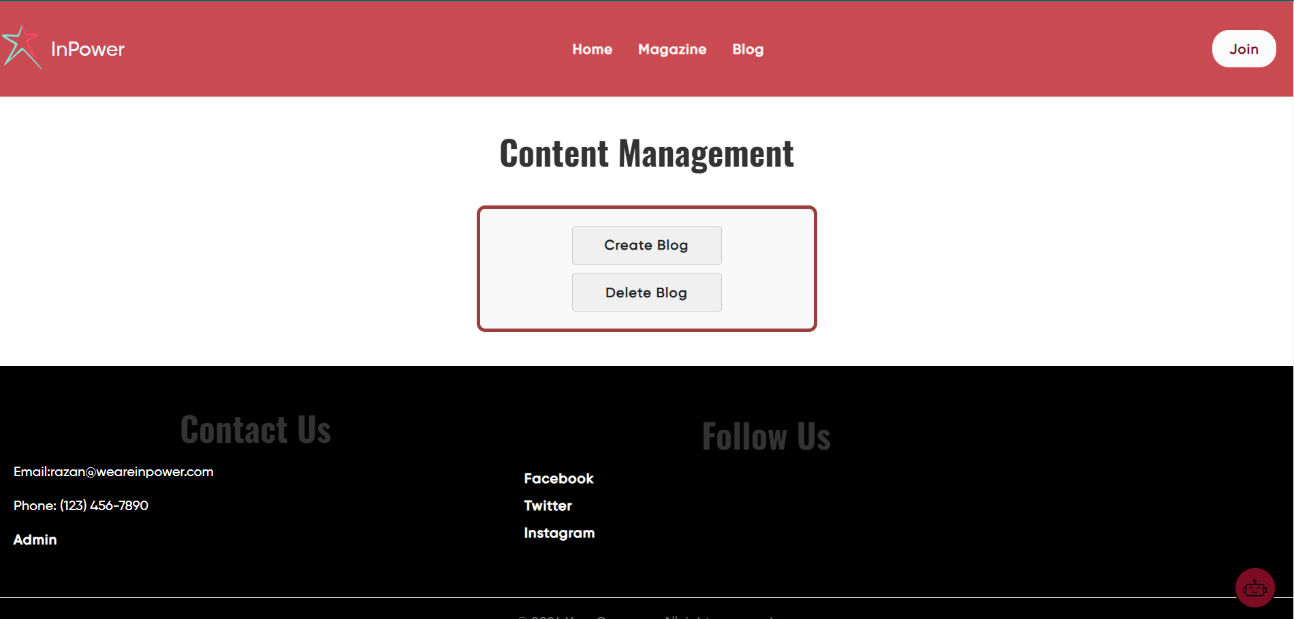
Layout

Slide 21
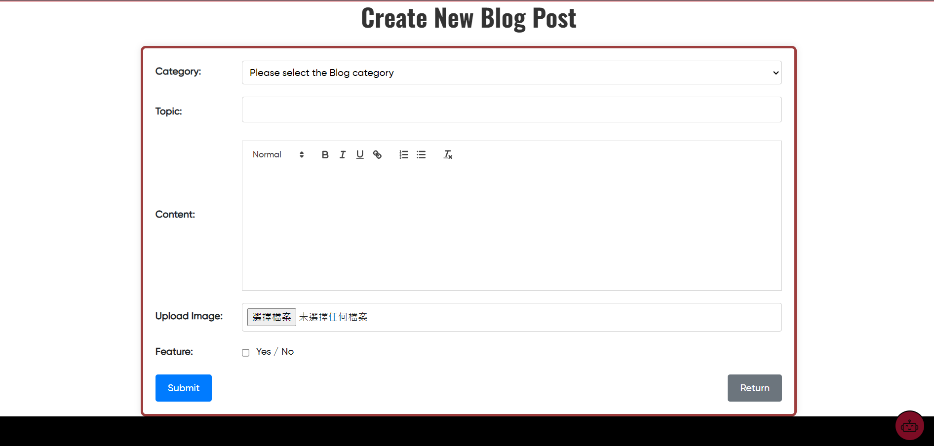
Layout

Slide 22
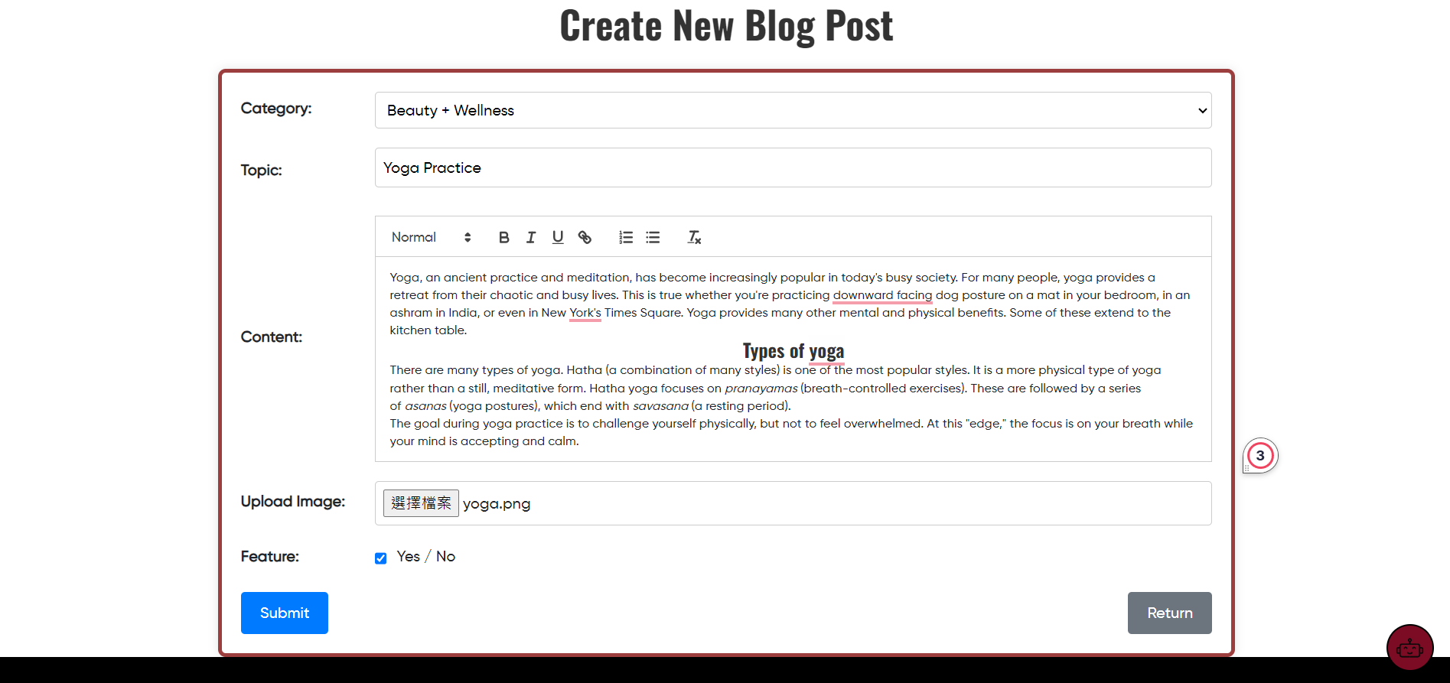
Layout

Slide 23
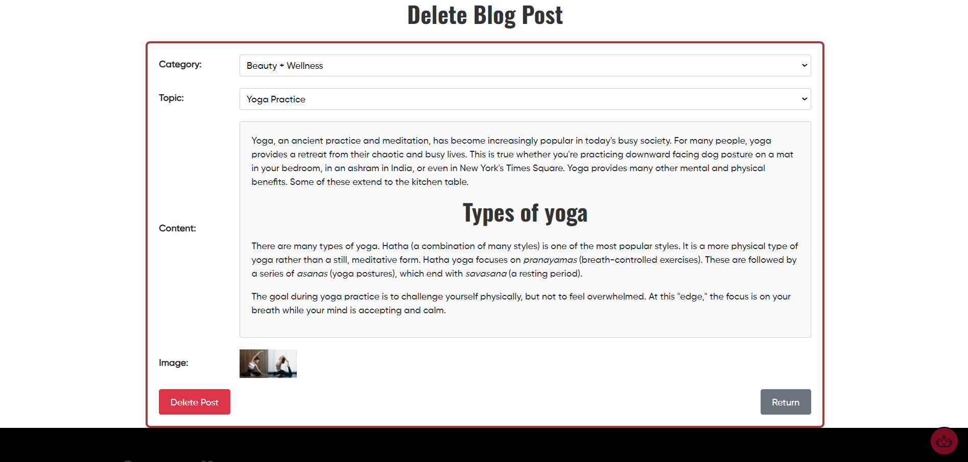
Layout

